Slide 1
Android SIG January Meeting
January 26, 2022

Slide 2
Antitrust Policy Notice
RISC-V International meetings involve participation by industry competitors, and it is the intention of RISC-V International to conduct all its activities in accordance with applicable antitrust and competition laws. It is therefore extremely important that attendees adhere to meeting agendas, and be aware of, and not participate in, any activities that are prohibited under applicable US state, federal or foreign antitrust and competition laws.
Examples of types of actions that are prohibited at RISC-V International meetings and in connection with RISC-V International activities are described in the RISC-V International Regulations Article 7 available here: https://riscv.org/regulations/
If you have questions about these matters, please contact your company counsel.

Slide 3
RISC-V International
RISC-V is a free and open ISA enabling a new era of processor innovation through open standard collaboration. Born in academia and research, RISC-V ISA delivers a new level of free, extensible software and hardware freedom on architecture, paving the way for the next 50 years of computing design and innovation.
We are a transparent, collaborative community where all are welcomed, and all members are encouraged to participate.
We as members, contributors, and leaders pledge to make participation in our community a harassment-free experience for everyone.
https://riscv.org/risc-v-international-community-code-of-conduct/

Slide 4
Agenda
Introduce collaborative source code repo(~15 min)
Main page
How to contribute
Android 12 RISC-V support status
Roadmap (~15 min) @Chen Guoyin
Open Discussion

Slide 5
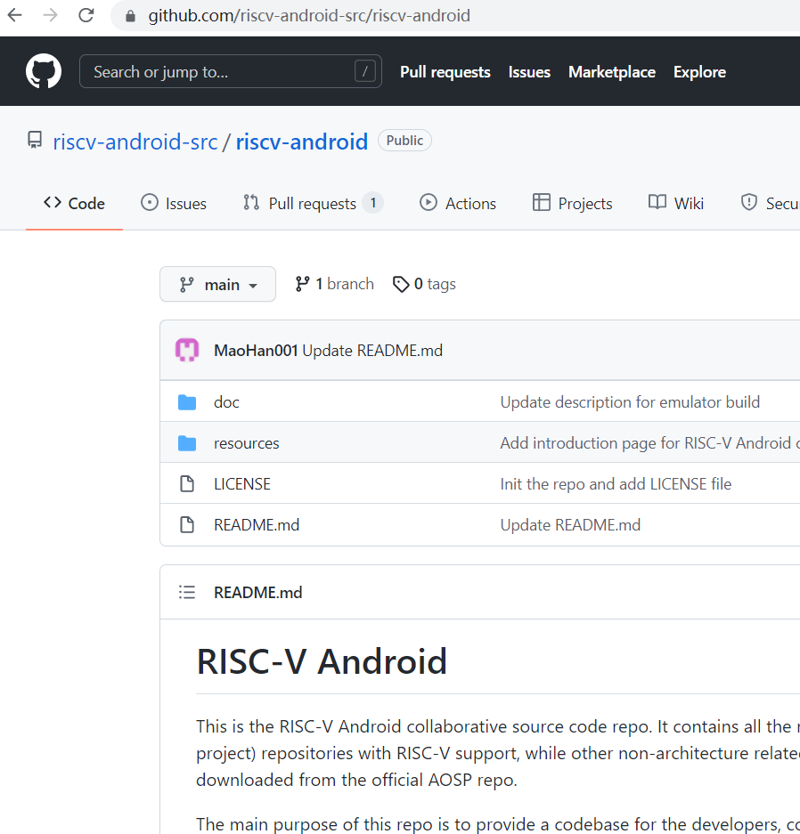
RISC-V Android collaborative source code repo
Main project RISC-V support base on android10-release
Main project RISC-V support base on android-12.0.0_r2
Prebuilt projects support for NDK, LLVM, RUST and emulator
100+ architecture related sub gits
Basic RISC-V arch support; bugfix & optimization required
https://github.com/riscv-android-src/riscv-android

Slide 6
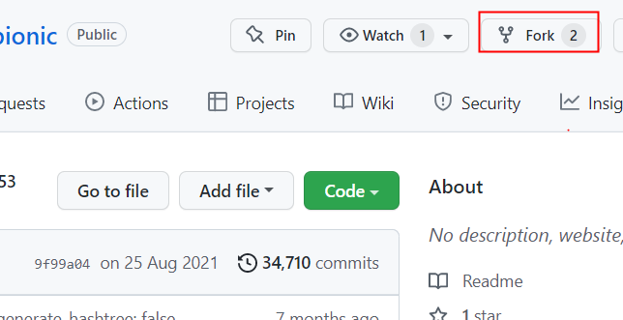
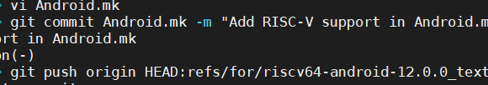
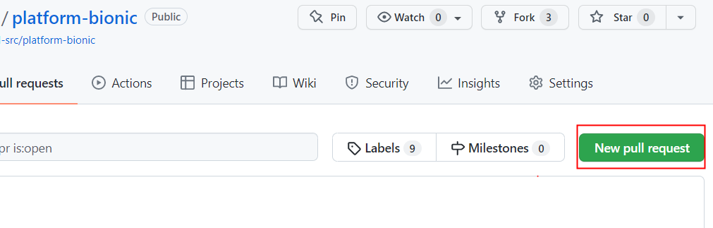
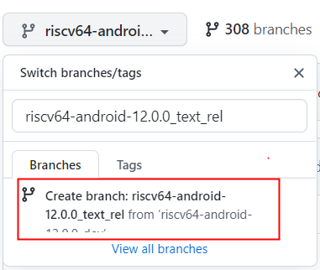
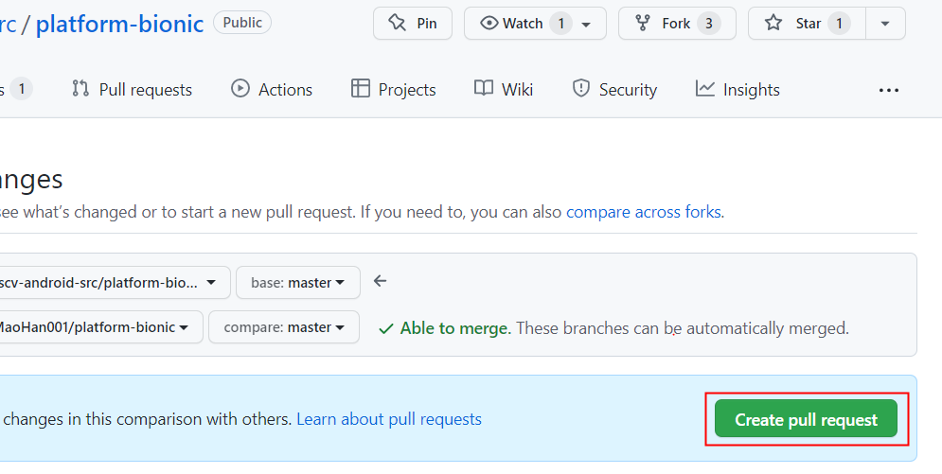
How to Contribute
> mkdir riscv-android-src
> cd riscv-android-src
> repo init -u git@github.com:riscv-android-src/manifest.git -b riscv64-android-12.0.0_dev
> repo sync
> source build/envsetup.sh
> lunch aosp_riscv64-eng
> m -j
Setup a build environment
Fork the repository you want to change and create development branch
Commit your changes and send a pull request

Slide 7
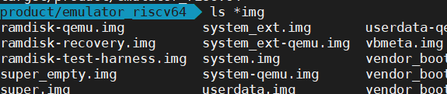
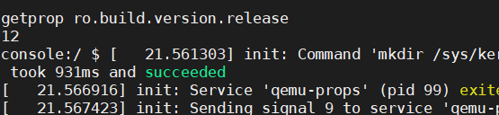
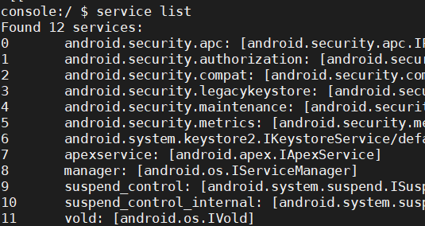
Android 12 RISC-V support status
Basic build infrastructure for RISC-V is supported(Bazel, RUST…)
Super, system, vendor, ramdisk, userdata images can be generated
NDK, SDK can be generated with Android 12
Can boot to console with emulator
Several native services are started, Bootanimation and 20+ other native services need debug

Slide 8
Android 12 RISC-V support status
ART port for 12 is still under going
Some security features are not enabled
Some workarounds need cleanup
lto&thin and cfi are not supported yet
Some Feature enabled on Android 10, haven’t been pick to Android 12 yet(multimedia, gallery, camera, NN)

Slide 9


Roadmap
2021/07
Sig-android First Meeting
2021/Q4
Android 12 Base Enablement
2022/Q2
Android 12 Full Feature Enablement
2022/Q4
Android 13 Upgrade
2023/Q3
Android 13 Optimization
2023/Q2
Android AOSP upstream
2023/Q3
RISC-V AOSP Android 14
Community Android

Slide 10
Open Discussion
Any other high priority submodules that we should make more effort on?
App development?
Native Bridge support?

Slide 11
Thank You

Slide 12
Extra (bionic test from Android 10)
[ FAILED ] 16 tests, listed below:
[ FAILED ] ifunc.function RV clang don’t support ifunc relocate
[ FAILED ] math_h.lrint lrint common implementation don’t support round mode
[ FAILED ] math_h.rint rint common implementation don’t support round mode
[ FAILED ] math_h.nearbyint nearbyint common implementation don’t support round mode
[ FAILED ] math_h_force_long_double.lrint lrint common implementation don’t support round mode
[ FAILED ] math_h_force_long_double.rint rint common implementation don’t support round mode
[ FAILED ] math_h_force_long_double.nearbyint nearbyint common implementation don’t support round mode
[ FAILED ] setjmp.setjmp_cookie_checksum checksum need extra implementation
[ FAILED ] stdio_nofortify.snprintf_sscanf_inf_nan rv float spec define nan to be positive
[ FAILED ] stdio_nofortify.swprintf_swscanf_inf_nan rv float spec define nan to be positive
[ FAILED ] stdio.snprintf_sscanf_inf_nan rv float spec define nan to be positive
[ FAILED ] stdio.swprintf_swscanf_inf_nan rv float spec define nan to be positive
[ FAILED ] sys_ptrace.watchpoint_stress Linux kernel ptrace missing function implementation
[ FAILED ] sys_ptrace.watchpoint_imprecise Linux kernel ptrace missing function implementation
[ FAILED ] sys_ptrace.hardware_breakpoint Linuxkernel ptrace missing function implementation
[ FAILED ] dlfcn.segment_gap qemu don’t have correct exception context
16 FAILED TESTS

